Slide 1
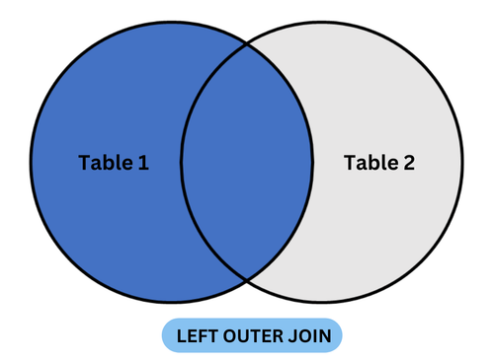

SQL SERVER JOINS

Slide 2

JOINS
Joins are used to retrieve the data from two or more related tables.
Tables are related to each other using the primary key and foreign key relationship but it is not mandatory.
Using JOINs, we can also perform UPDATE, DELETE, and INSERT operations by combining data from multiple related tables.

Slide 3

WHY ?
Joins are used to fetch meaningful, combined information from normalized tables using relationship like foreign key ,primary key.
EX:
Employee Table (ID,Name,DeparmentID)
Department (ID ,Name)
Without join we can’t get the employee’s department name directly

Slide 4
TYPES OF JOINS
INNER JOIN
OUTER JOIN
LEFT OUTER JOIN
RIGHT OUTER JOIN
FULL OUTER JOIN
CROSS JOIN
SELF JOIN

Slide 5
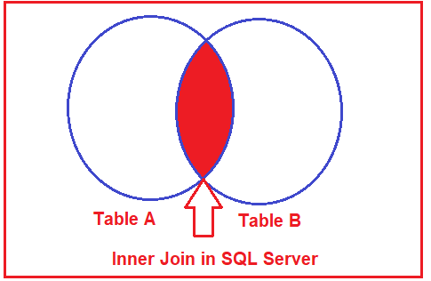
INNER JOIN
The Inner Join in SQL Server is used to return only the matching rows from both the tables involved in the join by removing the non-matching records.
Instead of using the INNER JOIN keyword, we can also use the JOIN .JOIN or INNER JOIN means the same.
SYNTAX:
SELECT columns
FROM TableA
INNER JOIN TableB
ON TableA.CommonColumn = TableB.CommonColumn;

Slide 6
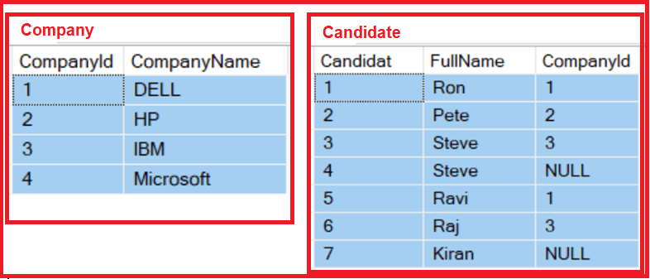
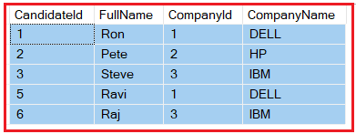
Example :
SELECT Cand.CandidateId, Cand.FullName, Cand.CompanyId, Comp.CompanyName
FROM Candidate Cand
INNER JOIN Company Comp ON Cand.CompanyId = Comp.CompanyId;

Slide 7
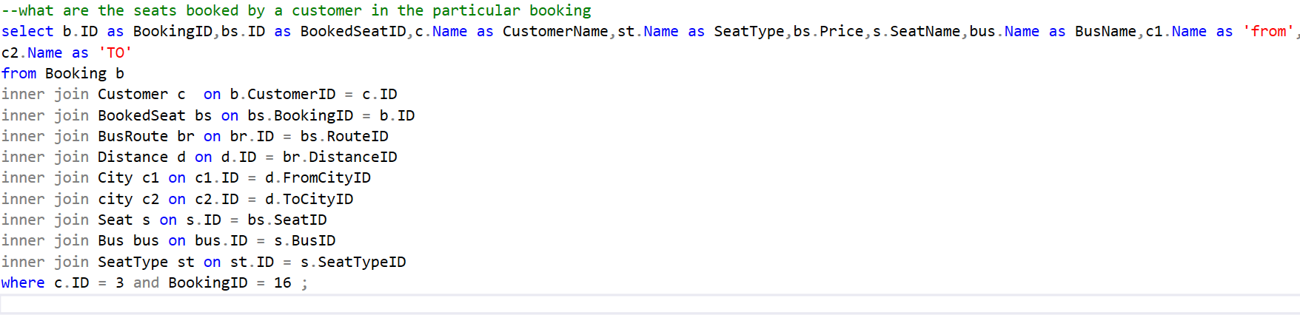
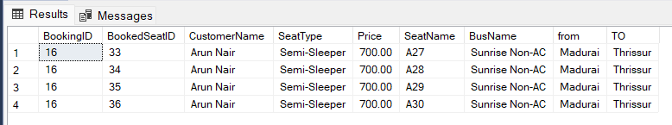

Slide 8
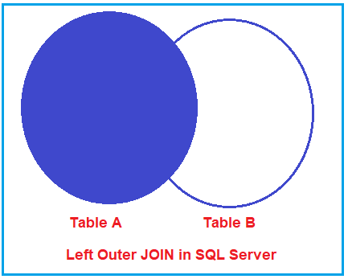
OUTER JOIN
LEFT OUTER JOIN:
A LEFT OUTER JOIN returns all records from the left table and the matched records from the right table. If there is no match, the result is NULL on the side of the right table.
LEFT OUTER JOIN or LEFT JOIN means the same.
SYNTAX:
SELECT columns
FROM TableA
LEFT OUTER JOIN TableB
ON TableA.CommonColumn = TableB.CommonColumn;

Slide 9
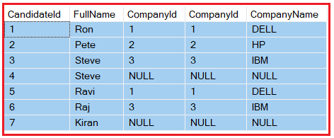
Example
SELECT Cand.CandidateId, Cand.FullName, Cand.CompanyId, Comp.CompanyId, Comp.CompanyName
FROM Candidate Cand
LEFT OUTER JOIN Company Comp ON Cand.CompanyId = Comp.CompanyId;

Slide 10
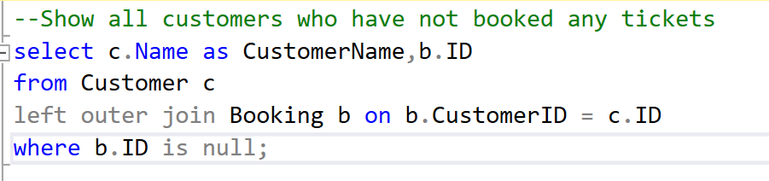
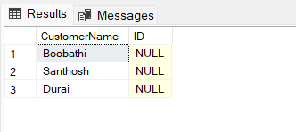
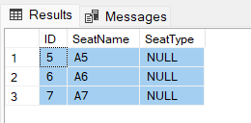
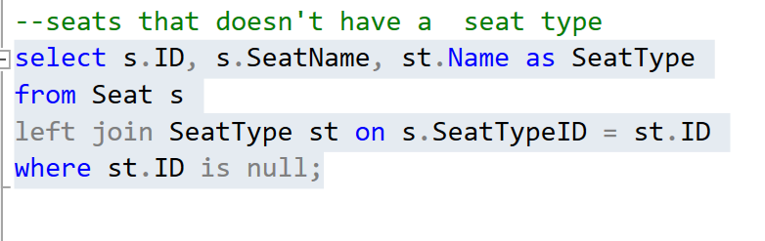

Slide 11
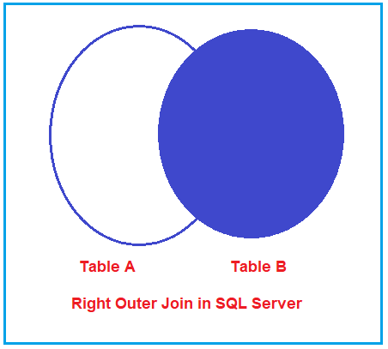
RIGHT OUTER JOIN
The Right Outer Join in SQL Server is used to retrieve all the matching records from both the tables involved in the join as well as all the non-matching records from the right-hand side table.
SYNTAX:
SELECT columns
FROM TableA
RIGHT OUTER JOIN TableB
ON TableA.CommonColumn = TableB.CommonColumn;

Slide 12
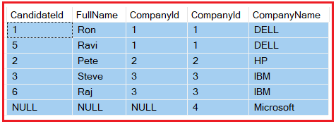
Example:
SELECT Cand.CandidateId, Cand.FullName, Cand.CompanyId, Comp.CompanyId, Comp.CompanyName
FROM Candidate Cand
RIGHT OUTER JOIN Company Comp ON Cand.CompanyId = Comp.CompanyId

Slide 13
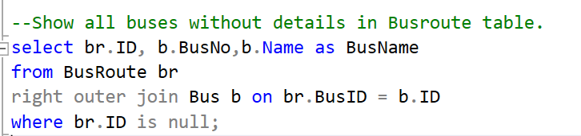
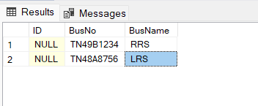
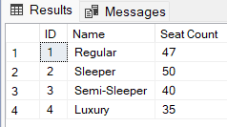
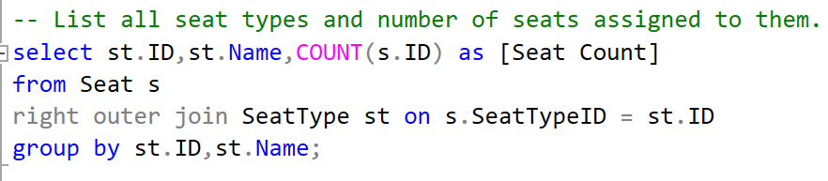

Slide 14
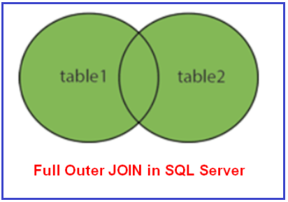
FULL OUTER JOIN
The Full Outer Join in SQL Server is used to retrieve all the matching records from both the tables involved in the join as well as all the non-matching records from both the tables.
The Un-matching data in such cases will take the null value.
FULL OUTER JOIN or FULL JOIN means the same.
SYNTAX:
SELECT columns
FROM TableA
FULL OUTER JOIN TableB
ON TableA.CommonColumn = TableB.CommonColumn;

Slide 15
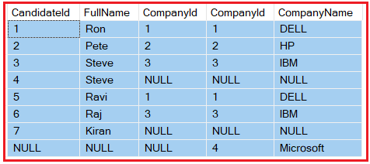
Example:
SELECT Cand.CandidateId, Cand.FullName, Cand.CompanyId, Comp.CompanyId, Comp.CompanyName
FROM Candidate Cand
FULL OUTER JOIN Company Comp ON Cand.CompanyId = Comp.CompanyId

Slide 16
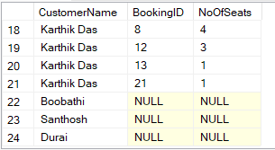
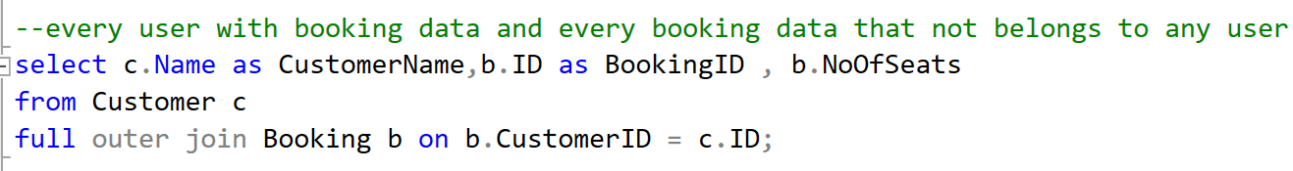
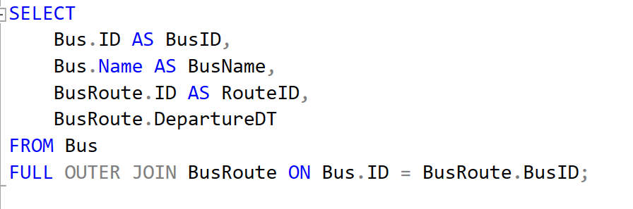
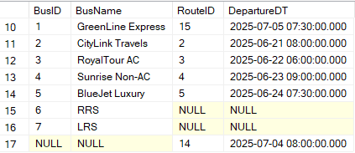

Slide 17
SELF JOIN
The Self Join is nothing a concept where we need to join a table by itself.
You need to use Self Join when you have some relations between the columns of the same table.
SYNTAX:
SELECT A.columns, B.columns
FROM Table A
JOIN Table B
ON A.Column = B.ColumnInSameTable;

Slide 18
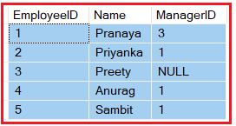
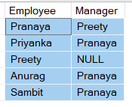
Example SELECT E.Name as Employee, M.Name as Manager FROM Employee E INNER JOIN Employee M ON E.ManagerId = M.EmployeeId

Slide 19
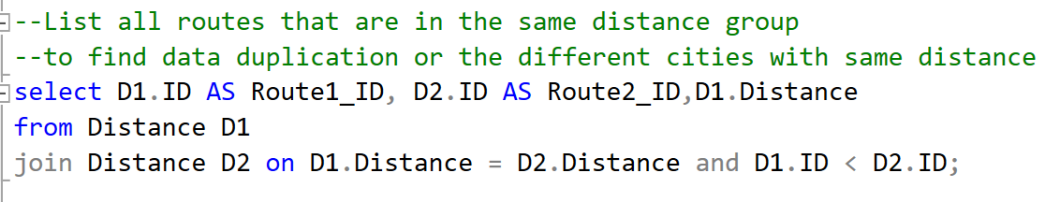
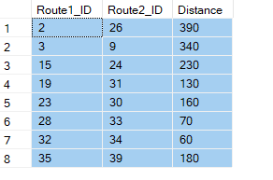

Slide 20
CROSS JOIN
When we combine two or more tables with each other without any condition (where or on) then we call this type of joins Cartesian or cross join.
each record of a table is joined with each record of the other table involved in the join. In SQL Server, the Cross Join should not have either ON or where clause.
Multiply of no of records in both tables
EX : Employee – 5 records and Department – 10 records then 50 records will be the output of cross join

Slide 21
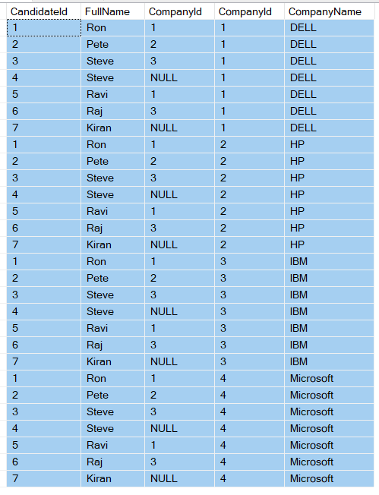
SELECT Cand.CandidateId, Cand.FullName, Cand.CompanyId, Comp.CompanyId, Comp.CompanyName
FROM Candidate Cand
CROSS JOIN Company Comp

Slide 22
UPDATE WITH JOIN
Example
When payment failed update booking = cancelled
UPDATE B
SET B.Status = 'Cancelled'
FROM Booking B
JOIN Payment P ON B.PaymentID = P.ID
WHERE P.StatusID = 3;
SYNTAX
UPDATE A
SET A.Column = B.Column
FROM TableA A
JOIN TableB B ON A.ID = B.ID
WHERE B.SomeColumn = 'value';

Slide 23
DELETE WITH JOIN
SYNTAX:
UPDATE A
SET A.Column = B.Column
FROM TableA A
JOIN TableB B ON A.ID = B.ID
WHERE B.SomeColumn = 'value';
Example:
Delete inactive users
DELETE P
FROM Passenger P
LEFT JOIN Booking B ON P.ID = B.PassengerID
WHERE B.ID IS NULL;

Slide 24
INSERT WITH JOIN
SYNTAX:
INSERT INTO TableC (Column1, Column2)
SELECT A.Col, B.Col
FROM TableA A
JOIN TableB B ON A.ID = B.ID
WHERE A.Condition = 'value';
Example:
Insert all base seat price
INSERT INTO SeatPrice (BusID, SeatTypeID, Price)
SELECT B.ID, S.ID, 500
FROM Bus B
CROSS JOIN SeatType S;

Slide 25
ADVANTAGES
Combines related data from multiple tables in a single query.
Improves readability and maintains normalized database design.
Faster performance than subqueries in many cases.
Reduces data duplication and keeps storage efficient.
Powerful query capability for reporting and analytics.
DISADVANTAGES
Complexity increases with multiple joins and large schemas.
Performance issues on large datasets if not indexed properly.
NULL values handling can be tricky in outer joins.
Can produce large result sets (especially with CROSS JOINs or missing filters).

Slide 26
ALTERNATIVES
Sub queries – often slower than join in large data sets
Union / union all – works well when schema is same
Common table Expression

